Slide 1



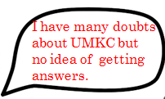


Slide 2
ASK UMKC
Sravan Varma
Architha Mukka
Vikesh Padarthi
Manikanta Maddula

Slide 3
INTRODUCTION
The Application is about questionnaires where any user can post a question and answer.
The questions need not be in specific area like finance, course and sports etc., it can be of any topic related to university activities like events, career, etc.
Student who wants to join UMKC will have many doubts like ‘last date for paying fee!’, ‘where is a particular event?’, ‘Student associations ’etc.
It is easy to drop a mail to the authorities asking for details but if answer is needed on weekends and on holidays, it’s difficult. But with this application, user gets answer at any time.

Slide 4
FEATURES
Login with GMAIL or with user credentials
Register for new users.
Displays various fields like Academic, Non-Academic, Admissions, Career, Update Profile, FAQ.
Ask button to post a question of any field.
Single question with multiple answers.
Search bar to search any question.
LIKE, UNLIKE, FOLLOW, UNFOLLOW, Followed by buttons.
Speech to text conversion.
GMAIL Notifications.

Slide 5
IMPLEMENTATION
Implemented the whole application in android studio. Mobile client application enable users to access the applications on their smart phones unlike web applications which need PC to access the application.
The source code is written in java and used bootstrap to implement GUI of our application. The database is maintained by Mongo DB.

Slide 6
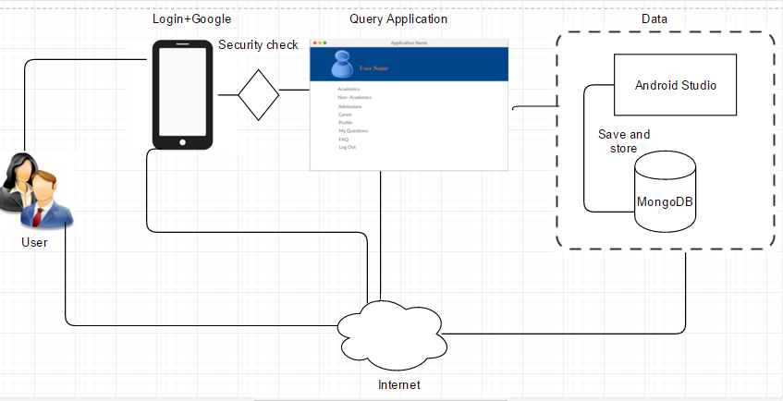
SYSTEM ARCHITECTURE

Slide 7
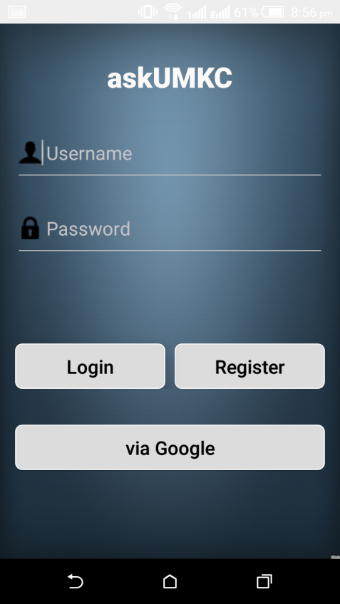
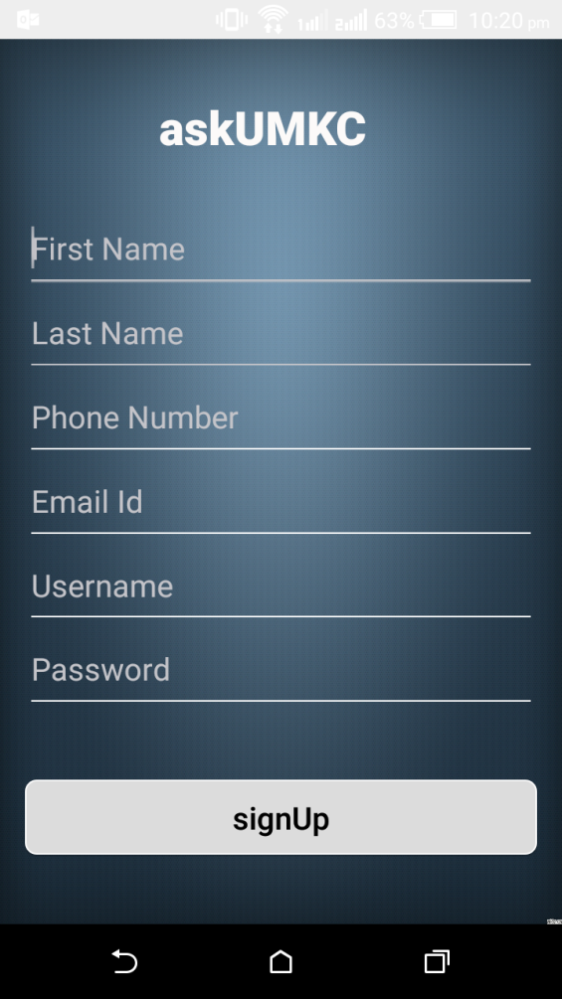
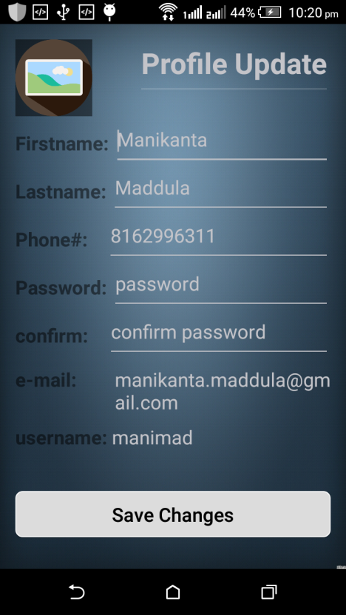
DEPLOYMENT
LOGIN PAGE
REGISTER PAGE
PROFILE UPDATE

Slide 8
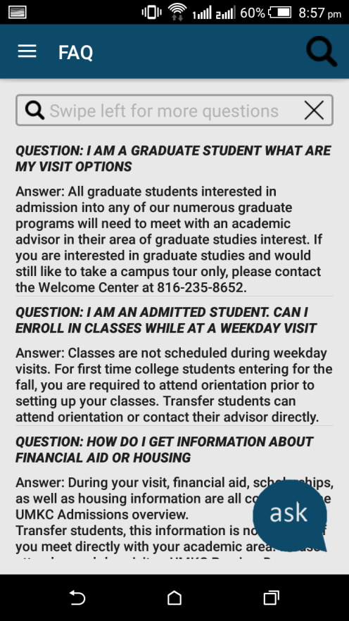
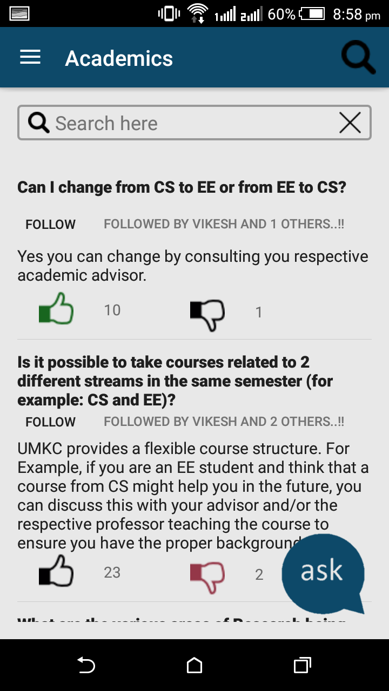
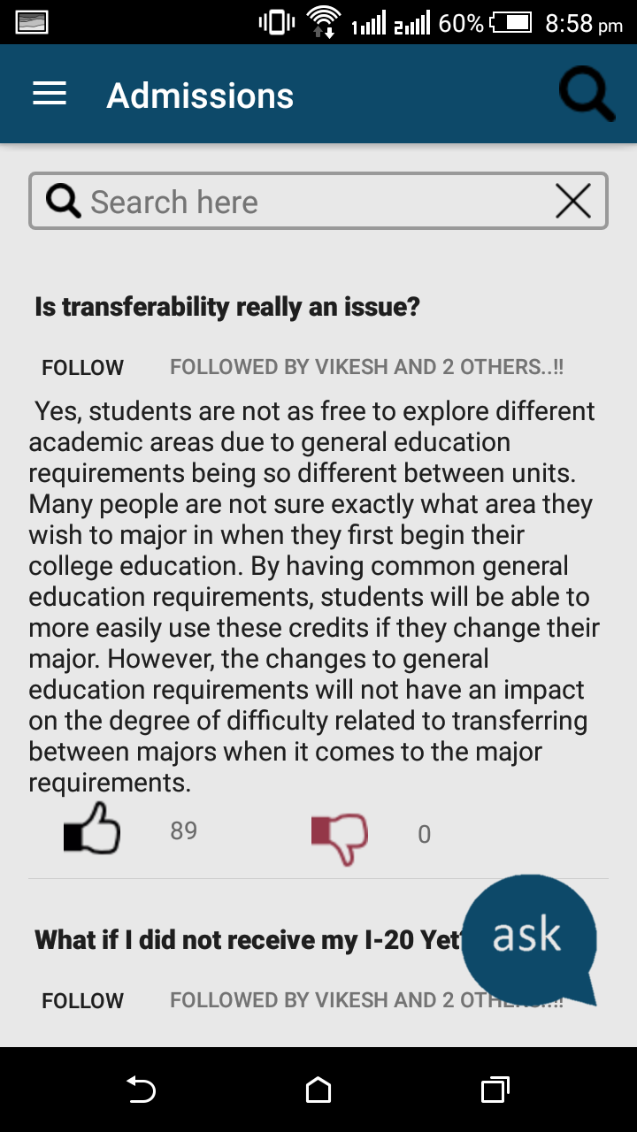
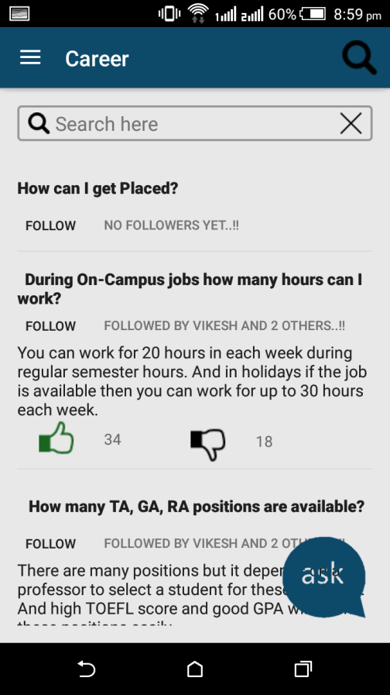
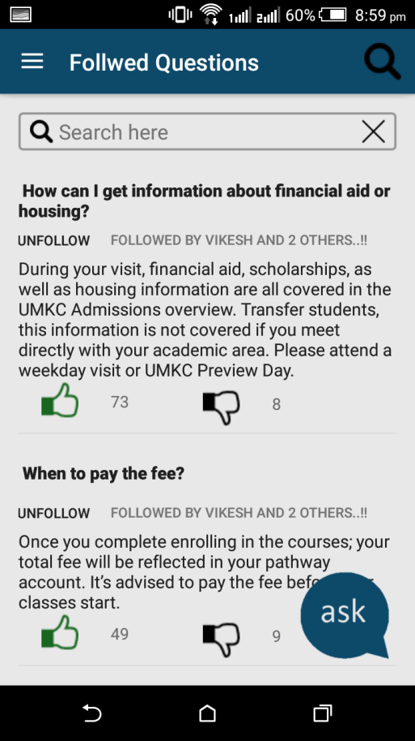
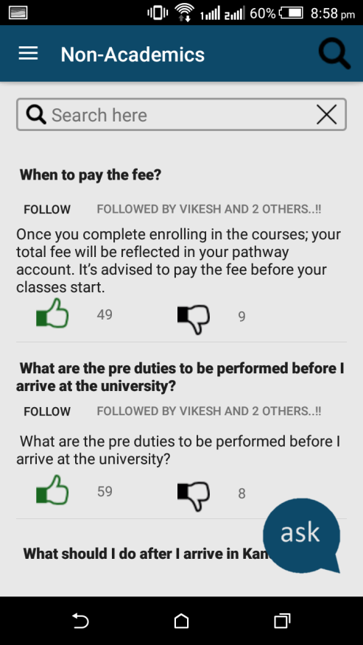
CATEGORIES

Slide 9
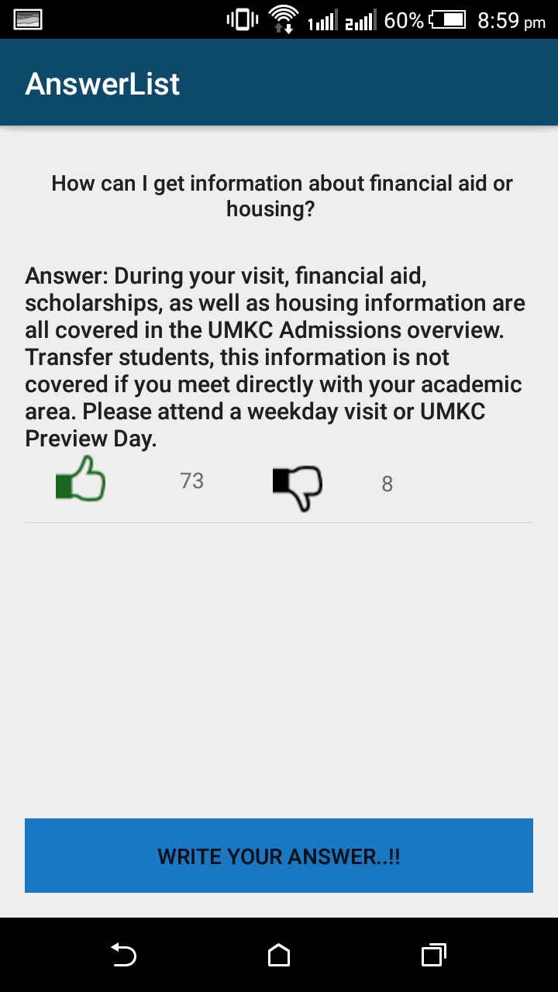
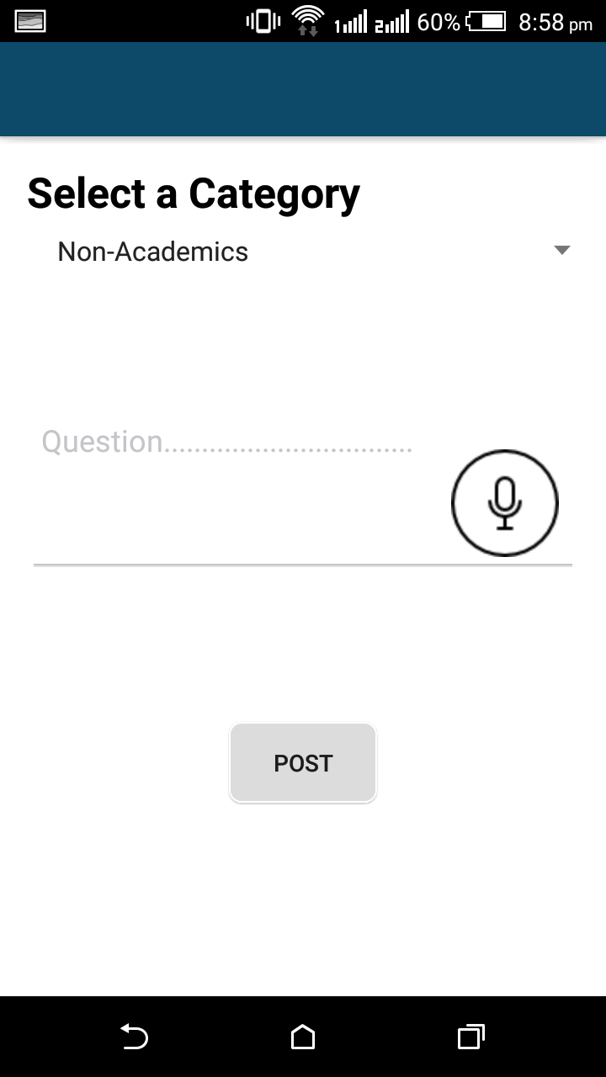
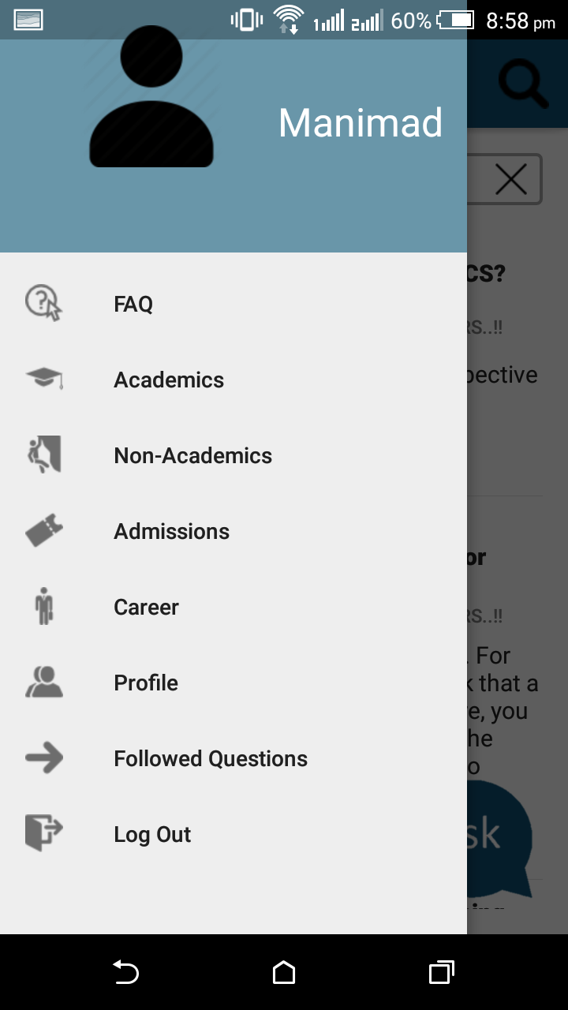
CATEGORIES
ANSWER LIST
POST QUESTION

Slide 10


